Slide 1
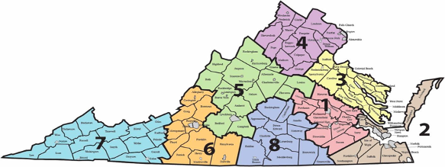
Introductions
Work-Based Learning Coordinator:
Sharon Acuff
Regional Work-Based Learning Specialists:
Dr. Nikki Finley
Erika Temple, MBA
Hiring for Region 4, 5, 6 and 7 Work-Based Learning Specialists
By the summer of 2022 all Superintendent’s Regions will be represented by a Regional Work-Based Learning Specialist
Notes:
Erika
VDOE Updates/Introductions
Virginia is grouped into 8 Superintendent Regions. We have a Statewide Work-Based Learning Coordinator: Sharon Acuff
We take a Regional approach to our Work-Based Learning Specialist assignments.
I am Erika Temple, a regional Work-Based Learning Specialist and I am joined by Dr. Nikki Finley who is also serves as a WBL Specialist
The Virginia Department of Education (VDOE) is in the process of hiring 4 additional Work-Based Learning
Region 4: Northern Virginia
Region 5: Shenandoah Valley
Region 6: Roanoke Valley Area
Region 7: Southwest Virginia
By summer 2022, we will have hired a total of 8 WBL Specialists will allow for each region to have its own Specialist to dedicate 100% work effort to achieving High-Quality WBL goals in each region.

Slide 2
High-Quality Work-Based Learning (WBL) in Virginia
Notes:
Erika

Slide 3
12 High-Quality WBL Experiences
Grades 6-12
Grades 9-12
Externship
Job Shadowing
Service Learning
Mentorship
School-Based Enterprise
Internship
Supervised Agricultural Experience*
*Added July 1, 2021
Cooperative Education
Registered Apprenticeship
Entrepreneurship
Clinical Experience
Youth Registered Apprenticeship
Notes:
High-Quality WBL Experiences
High-Quality Work-Based Learning (WBL) is comprised of experiences related to students’ career interests, based on instructional preparation, and undertaken in partnership with local businesses or organizations. The Virginia Department of Education (VDOE) recognizes 12 WBL experiences. These 12 WBL experiences promote the following:
Career Awareness
Career Exploration
Career Preparation
This diagram identifies the 12 WBL methods practiced in Virginia and what grade levels the experiences can be offered to students. The experiences for students begin with less intense opportunities such as job shadowing, to more intensive opportunities such as cooperative education and youth registered apprenticeship.

Slide 4
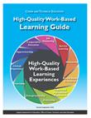
WBL Guide Revisions Effective July 1, 2021
In addition to, as in the past,
Cooperative Education – 280 hours earns one credit
Internship – 280 hours earns one credit
Mentorship – 140 hours earns one half credit
Youth Registered Apprenticeship (YRA) – 280 hours earns one
credit
Effective July 1, 2021, students are offered more credit
options toward graduation when completing:
Entrepreneurship - 280 hours earns one credit
Supervised Agricultural Immersion Experiences (SAE) – 280 hours earns one credit
Notes:
Erika

Slide 5
Developing a Strategic Communications Plan
Notes:
Erika

Slide 6
Strategic Communications Plan
Goal | Objective | Audience (Whom) | Message(s) | Channel | Method | Time/ Frequency | Person(s) Responsible | Evaluation
Establish a professional network among secondary, post- secondary, and business and industry | Develop consistent WBL guidelines for all stakeholders | WBL Coordinator/(POC) | WBL Methods/ best practices for business partners connecting with school divisions | CTE Summer Professional Associations Conferences | Google Slides presentation Pre Recorded Videos | July- Annual | Work-Based Learning Team | YouTube Views on Online PD/ Increase in number of contacts
Notes:
Goals
Identifying all Stakeholders
Objectives
Consistent Messages
Channel
Methods
Evaluation/ Measurement

Slide 7
Work-Based Learning Statewide Launch
Posting Videos on YouTube
Regional CTE Administrators Meetings
Individual Meet and Greets
CTE Summer Professional Conferences
Conveying a Consistent High-Quality WBL Message

Slide 8
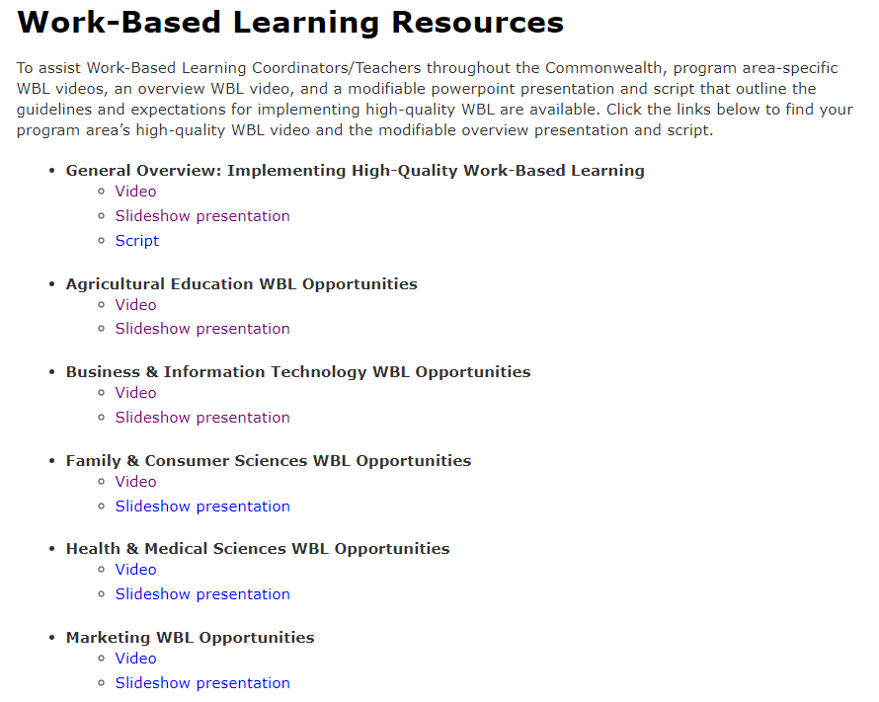
Work-Based Learning Resources
General Overview: Implementing High-Quality WBL
Video
Slideshow presentation
Script
Program Area videos and slideshow presentations
Recording Wages and Hours
WBL Guide
http://cteresource.org/curriculum/work-based-learning/index.html

Slide 9
Future Communication Methods for School Divisions and Businesses
Create one-pagers for each WBL experience
Develop a frequently asked questions document for businesses and school divisions
Submit WBL articles for CTE Newsletter
Create a WBL Guide for businesses
Develop a training handbook for new school division WBL coordinators
Share testimonials and best practices from business partners and students

Slide 10
Contact Information
Sharon Acuff
Work-Based Learning Coordinator - Regions 3, 4 and 5
sharon.acuff@doe.virginia.gov
Nikki Finley, Ph.D.
Work-Based Learning Specialist - Regions 1, 2 and 8
nikki.finley@doe.virginia.gov
Erika Temple
Work-Based Learning Specialist - Regions 6 and 7
erika.temple@doe.virginia.gov

